Slide 1
Border Gateway Protocol
CSE 118: Computer Networks
George Varghese
Computing routes from UCLA to the world as opposed to computing routes within UCLA
Many slides courtesy Alex Snoeren

Slide 2
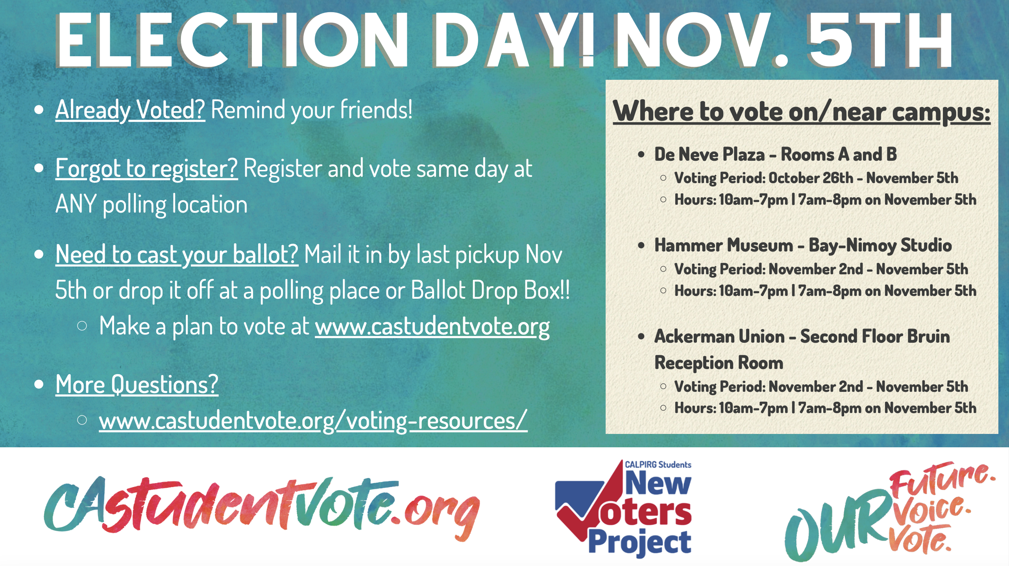
REMINDER TO VOTE FROM AVALON KELLY OF UCLA AND CAL PIRG

Slide 3
IP’s Abstract View of World
Network 10
Network Numbers were 8, 16, or 24 bits
Network
2
Internet
Network z
Network y

Slide 4
Classless New World: Prefixes
123.32/16
18.32.3/24
Internet
11.12.1.1/30
192.2.3.4/28

Slide 5
IP Addresses and Prefixes
32 bytes written as A.B.C.D, where A, B, C, D are integers from 1 to 255 representing one byte of IP address
.For example, an EE server in CMU can be 128.2.1.155, first byte is 10000000
A Prefix is represented by slash or wildcard notation, For example CMU is 128.2/16 which means that all IP addresses in CMU start with 10000000 0000 0010 *
Another way to encode prefixes is with a mask. For example, to represent a /16 use a bit mask with 16 1’s and 16 0’s. So you can AND with mask to find prefix

Slide 6
Get Started by DHCP and ARP
B:, 128.2.15.16
EE, 128.2.1/24
Philos, 128.2.15/24
128.2.15.*
A:, 128.2.1.155
DNS
Server
128.2.10.*
DHCP
Server
CMU (128.2/16)

Slide 7
So far: Route Computation within an Autonomous System (AS)
Philos, 128.2.15/24
128.2.15.*
EE, 128.2.1/24
128.2.10.*
Hist, 128.2.10/24
CMU (128.2/16)
AS9
Link State, or Distance Vector used within
AS between routes to compute routes

Slide 8
BGP: Routing between ASes
Shorter AS Paths are
more preferred
AS9
128.2/16 9
CMU (128.2/16)
128.2/16 9
AS701
AS7018
UUnet
AT&T
128.2/16
9 7018
128.2/16
9 701
128.2/16
9 7018 1239
AS73
AS1239
Univ of Wash
Sprint

Slide 9
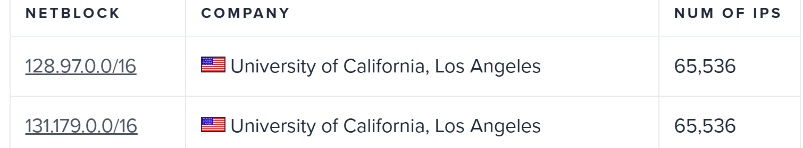
UCLA (from ipinfo.io)
Many more including three more /16’s and many /24’s

Slide 10
How Prefixes help us scale
Shorter AS Paths are
more preferred
AS9
* → R2
R1
CMU (128.2/16)
AS701
R2
128.97. *→ R3
UUnet
R3
AS52
128.97. *→ R4
UCLA CS Web Server
128.97.1.1
R4
R5
128.97.1. *→ R5
UCLA

Slide 11
Why Interdomain Routing: Policy

Slide 12
Possible Polices

Slide 13
BGP Overview
Border Gateway Protocol (BGP)
The canonical path vector protocol
How routing gets done on the Internet today
AS relationships
Customer/Provider
Multihoming
Peer-to-peer
Internet AS hierarchy

Slide 14
Border Gateway Protocol
Interdomain routing protocol for the Internet
Prefix-based path-vector protocol
Policy-based routing based on AS Paths
Evolved during the past 28 years
1989 : BGP-1 [RFC 1105], replacement for EGP
1990 : BGP-2 [RFC 1163]
1991 : BGP-3 [RFC 1267]
1995 : BGP-4 [RFC 1771], support for CIDR
2006 : BGP-4 [RFC 4271], update

Slide 15
Basic BGP Operation
Establish session
AS1
BGP session
Exchange all
active routes
AS2
Exchange incremental
updates
While connection
is ALIVE exchange
route UPDATE messages

Slide 16
Step-by-Step
A node learns multiple paths to destination
Stores all of the routes in a routing table
Applies policy to select a single active route
… and may advertise the route to its neighbors
Incremental updates unlike distance vector
Announcement
Upon selecting a new active route, add own node id to path
… and (optionally) advertise to each neighbor
Withdrawal
If the active route is no longer available
… send a withdrawal message to the neighbors

Slide 17
A Simple BGP Route
Destination prefix (e.g., 128.112.0.0/16)
Route attributes, including
AS path (e.g., “7018 88”)
Next-hop IP address (e.g., 12.127.0.121)
192.0.2.1
12.127.0.121
AS 7018
AT&T
AS 88
AS 11
Princeton
Harvard
128.112.0.0/16
AS path = 88
Next Hop = 192.0.2.1
128.112.0.0/16
AS path = 7018 88
Next Hop = 12.127.0.121

Slide 18
Data Packets flow in opposite direction from BGP updates
Notice how Next Hop Info from last slide is crucial to build forwarding table at each route used to choose next hop
Have to do ARP as well to get MAC address of next hop
192.0.2.1
12.127.0.121
AS 7018
AT&T
AS 88
AS 11
Princeton
Harvard
To D from S
Next Hop = 192.0.2.1
To D from S
Next Hop = 12.127.0.121
Source = S
Dest = D 128.112.3.1

Slide 19
Distance Vector versus BGP
Only way in distance vector to tune routes is via cost
In BGP, one can “control” routes in more complex ways
128.112.0.0/16
Cost = 30
128.112.0.0/16
AS Path = 152 33 88
Community = 10
128.112.0.0/16
AS Path = 52 152 33 88
Community = 10
20
10
128.112.0.0/16
Cost = 30
128.112.0.0/16
Cost = 40
128.112.0.0/16
AS Path = 7018 88
Community = 8
Distance Vector, within an AS,
only attribute is cost, Always
Pick & propagate shortest
Path Vector, between ASes,
Multiple attributes, Complex
Choices settable in config files

Slide 20
(some) BGP Attributes
AS path: ASs the announcement traversed
Next-hop: where the route was heard from
Origin: Route came from Inside (IGP) or outside (EGP)
Local pref: Statically configured ranking of routes within AS
Multi Exit Discriminator: preference for where to exit network
Community: opaque data used for tag routes that are to be treated equivalently.

Slide 21
BGP Decision Process
Default decision for route selection
Highest local pref, shortest AS path, lowest MED, prefer eBGP over iBGP, lowest IGP cost, router id
Many policies built on default decision process, but…
Possible to create arbitrary policies in principal
Any criteria: BGP attributes, source address, prime number of bytes in message, …
Can have separate policy for inbound routes, installed routes and outbound routes
Limited only by power of vendor-specific routing language

Slide 22
Example: Local Pref
AS 4
local pref = 80
AS 3
local pref = 90
AS 5
local pref = 100
Higher Local
preference values
are more preferred
AS 2
AS 1
13.13.0.0/16

Slide 23
Example: Short AS Path
Shorter AS Paths are
more preferred
AS9
128.2/16 9
CMU (128.2/16)
128.2/16 9
AS701
AS7018
UUnet
AT&T
128.2/16
9 7018
128.2/16
9 701
128.2/16
9 7018 1239
AS73
AS1239
Univ of Wash
Sprint

Slide 24
AS Paths vs. Router Paths
Mr. BGP says that
path 4 1 is better
than path 3 2 1
AS 4
AS 3
AS 2
AS 1

Slide 25
More intricate feature: MEDs
Way to do load balancing by passing a hint to next AS
Request Harvard send traffic to Princeton sciences via R2
128.112.12.0/24
AS path = 88
MED = 100
AS 7018
12.127.0.121
192.0.2.1
AS 88
AT&T
R1
Princeton
AS 11
R2
128.112.12.0/24
sciences
Harvard
128.112.12.0/24
AS path = 88
MED = 200
128.112.12.0/24
AS path = 7018 88
128.112.18.0/24
arts
MED removed before
Passing to Harvard

Slide 26
Doing MEDs in Cisco router config at Princeton exit
neighbor R1 route-map setMED-R1 out
neighbor R2 route-map setMED-R2 out
access-list 1 permit 128.112.12.0 255.255.255.0 // sciences
access-list 2 permit 128.112.18.0 255.255.255.0 // arts
route-map setMED-R1 … match ip address 1 set metric 100
// for R1 send science prefix with lower MED priority
route-map setMED-R1 … match ip address 2 set metric 200
// for R1 send arts prefix with higher MED prioriity
route-map setMED-R2 … match ip address 1 set metric 200
// for R2 send science prefix with higher MED priority
route-map setMED-R2 … match ip address 2 set metric 100
// for R2 send arts prefix with lower MED priority

Slide 27
Feature 2: community
Way to tag multiple routes with same tag value
Then remote routers can act on tag (e.g., filter)
AS 52
Filter if community = D
UCLA
AS 7018
128.2.0.0/16
CMU
ATT
128.112.0.0/16
ASPath =88 7018
Community = D
AS 701
UUNet
128.112.0.0/16
AS path = 88 7018
CMU and Princeton are not sent to
UUNET so UCLA does not provide transit
128.112.0.0/16
Princeton

Slide 28
Example: Aggregation

Slide 29
BGP Has Lots of Problems
Instability
Route flapping (network x.y/z goes down… tell everyone)
Long AS-path decision criteria defaults to DV-like behavior (bouncing)
Not guaranteed to converge, NP-hard to tell if it does
Scalability still a problem
>500,000 network prefixes in default-free table today
Tension: Want to manage traffic to very specific networks (eg. multihomed content providers) but also want to aggregate information.
Performance
Non-optimal, doesn’t balance load across paths

Slide 30
Business Relationships
Neighboring ASes have business contracts
How much traffic to carry
Which destinations to reach
How much money to pay
Common business relationships
Customer-provider
E.g., Princeton is a customer of USLEC
E.g., MIT is a customer of Level3
Peer-peer
E.g., UUNET is a peer of Sprint
E.g., Harvard is a peer of Harvard Business School

Slide 31

Multi-Homing
Customers may have more than one provider
Extra reliability, survive single ISP failure
Financial leverage through competition
Better performance by selecting better path
Gaming the 95th-percentile billing model
Provider 1
Provider 2

Slide 32
Scaling iBGP
The default way of a full mesh between all border routers has O(N^2) overhead, where N is # border routers
Two common ways to scale IBGP in large ISPs: confederations and route reflectors
In confederations, we divide a large AS into stub AS’s hierarchically, so stub AS’s don’t know internals of each
In route reflectors, leaf border routers send BGP messages to a central reflector that sends to all clients. Can generalize to a tree of reflectors.

Slide 33
Asking ChatGPT
When to Use Confederations
Very Large, Hierarchical Networks: Confederations are useful in large networks where the ISP has a very complex, hierarchical design,
Administrative Control and Scalability: Each sub-AS can have its own policies, making it easier to delegate control over different parts of the network.
When to Use Route Reflectors:
Simplified Design for Medium to Large Networks: Route reflectors simplify BGP by reducing the need for a full iBGP mesh without introducing the complexity of confederations. They’re a good choice for ISPs looking to scale a network that isn't complex enough to justify a confederation.

Slide 34
Conclusions
Link State and Distance vector are used to route within a Domain/AS/ISP/Enterprise
BGP is used to compute routes between ASes
Basically like distance vector gossip except you add not just a total cost but list of all Ass in path so far.
AS Path helps policy because any router can choose to drop based on AS’s in path.
AS Path also helps prevent loops without a hop count

